Slide 1

Bank management system
Develop a mini banking management system in C language that enables users to perform essential banking operations, including account creation, deposit, withdrawal, and balance inquiry. The system should ensure data security, handle multiple accounts, and provide a user-friendly interface for efficient and secure management of banking transactions.

Slide 2
structures
time_t t;
int x[20], y[20];
char a, ch, cpin[22], cpin1[22], username[] = "max", tusername[22];
int p, u, i = 0, j, J, in, I[22] = {0}, X, L = 0, cibil_score[10] = {700}; // i is for new acc counter and I[] is for transection counter p is independent
int temp_acc_number;
long int pin;

Slide 3
structures
Constrains
Maximum number of account 9

Slide 4
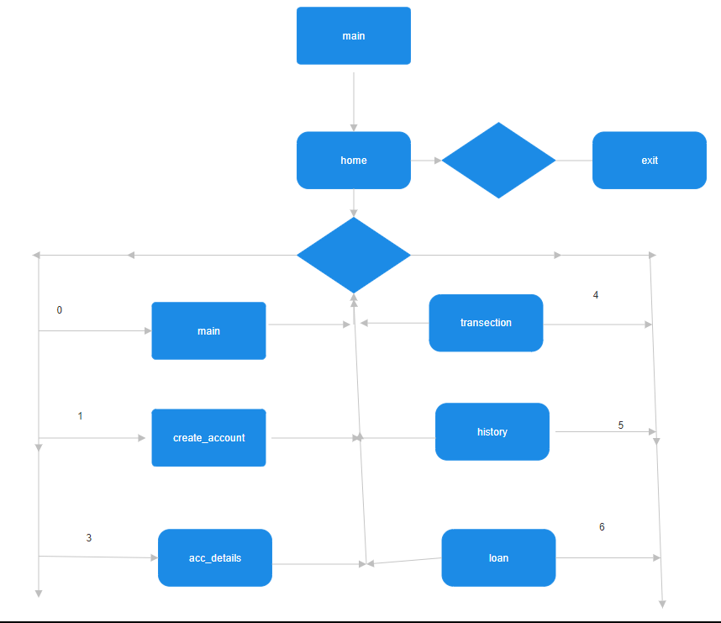


structures

Slide 5

structures
structures

Slide 6
Struct customer
So struct customer contains all information about account holder like:
data data type and variable name
Name char name[55]
Date of birth int dob[5]
Aadhar number long long int aadhar
Phone number long long int phone_number
Pan number char pan[22]
Address char aadrass [111]
Account type int acc_type
Account balance long long int acc_balance
Account number int acc_type
Cibil score int score

Slide 7

Struct loan l[10]
Its an array of 10 struts
In each struct we store loan info of each acc.holder like:
Data data type and variable name
Loan purpose char l_purpose[55]
Lone type char l_type[22]
Employment status chat employment status[20]
Account number char l_acc number
Income long long int m_income
Date of issue Int ldate[3]
Repay date int rdate[10]

Slide 8
Struct transection
It stores all transection information
Transection date
Transection amount
Balance at that time transection

Slide 9

start
Step 1.Declare Global Variables:
Declare global variables such as time_t t, arrays x and y, characters a, ch, cpin, cpin1, username, tusername, integers p, u, i, j, J, in, I, X, L, cibil_score, and temp_acc_number, and a long integer pin.
Step 2.Define Structures:
Define structures for transactions (struct tran), customer information (struct cust), and loans (struct loan).
Step 3.Define Functions:
Define functions for various actions, such as time-related functions (Time), setting initial values (set), user login (login), main user interface (home), depositing money (deposite), creating a new account (create_account), viewing account details (acc_details), withdrawing money (withdraw), viewing transaction history (history), managing date of birth (DOB), updating account information (acc_update), managing phone numbers (phone_number), managing Aadhar numbers (aadhar_number), managing PAN numbers (pan_number), performing transactions (transection), sending money (send1), applying for loans (loan), initializing loans (loanc), and viewing account information (acc).
Step 4.Main Function:
In the main function, clear the screen (clrscr), initialize loans (loanc), perform user login (login), and display the main user interface (home).

Slide 10
Algorithm for home Function:
Clear the Screen:
Use clrscr() to clear the screen.
Display Main Menu:
Print the main menu options.
Use getch() to get the user's choice.
Process User Choice:
Use a switch statement to process the user's choice.
If '1', call create_account.
If '2', get account number and call acc_details.
If '3', call transection.
If '4', call history.
If '5', call loan.
If 'esc' (ASCII 27), exit the program.
If none of the above, call home again.

Slide 11

Login function
Username Input:
The function starts by printing prompts and then enters a loop to read characters for the username.
It uses getch() to read a character without echoing it to the console.
The loop continues until the 'Enter' key (character 13) is pressed.
Backspace (character 8) is used to erase the last character if there is any.
The entered username is stored in the array tusername.
Username Validation:
After the username is entered, it compares the entered username (tusername) with a predefined username (username).
If the entered username is not correct, it clears the screen and recursively calls the login function again.
PIN Input:
After a correct username is entered, it prompts the user to enter a PIN.
It uses a loop to read digits for the PIN, allowing only numeric input (characters '0' to '9').
The entered PIN is displayed as asterisks ('*') for security.
The loop continues until the 'Enter' key is pressed.
PIN Validation:
It converts the entered PIN (cpin) to a numerical value (pin) using atol.
If the entered PIN is not correct (in this case, not equal to 261224), it clears the screen, displays an error message, and allows the user to re-enter the PIN by jumping to the pin label.

Slide 12
Account details
Displaying Account Details:
The function starts by printing a header for account details.
It then prints various pieces of information related to the account, such as name, date of birth, Aadhar number, phone number, PAN number, address, account balance, CIBIL score, and type of account.
The account type is displayed based on a switch statement that checks the value of m[in].acc_type.
User Interaction Loop:
After displaying the account details, the code enters a loop where it waits for user input using getch().
The loop continues until the user presses the 'Esc' key (ASCII 27) or enters a digit between 1 and 6.
If the user presses 'Esc', the home function is called.
If the user enters a digit between 1 and 6, the acc_update function is called, and then it jumps to the udone label reapeating same format.
Conditional Actions:
If the user presses 'Esc', the home function is called.
If the user enters a digit between 1 and 6, the acc_update function is called, and then it jumps to the udone label.
Infinite Loop and Exit Conditions:
The loop continues indefinitely until the user either presses 'Esc' or enters a digit between 1 and 6.
Depending on the user input, the function either goes back to displaying account details or returns to the home function.

Slide 13
Withdraw function
Clear Screen and Display Header:
The function starts by clearing the screen using clrscr() and then prints a header for the withdrawal section.
Amount Input:
It enters a loop to read characters for the withdrawal amount.
The loop continues until the 'Enter' key (ASCII 13) or 'Esc' key (ASCII 27) is pressed.
Backspace (ASCII 8) is used to erase the last character if there is any.
Only numeric input (characters '0' to '9') is accepted for the withdrawal amount.
The entered amount is stored in the cpin1 array.
Early Exit on 'Esc':
If the user presses 'Esc' during the amount input, it exits the loop and calls the home function.
Amount Conversion and Balance Check:
The entered amount (cpin1) is converted to a numerical value (h[in][I[in]].transfer) using atol.
It checks if the account balance (m[in].acc_balance) is sufficient for the withdrawal.
If the balance is insufficient, it prints a message and waits for the user to press any key.
Update Account Balance and Transaction Record:
If the balance is sufficient, it subtracts the withdrawal amount from the account balance.
It updates the transaction record (h[in][I[in]].balance) with the new account balance.
Display 'Done' Message and Timestamp:
Prints a "done" message and calls a function (Time()) to display a timestamp.
User Interaction Loop and Return to Home:
It waits for the user to press any key ('Esc' to exit or any other key to continue).
If the user presses 'Esc', it breaks out of the loop and clears the screen, returning to the home function.

Slide 14
Transection function
Account Number Input:
The function prompts the user to enter an account number.
It enters a loop to read characters for the account number.
The loop continues until the user presses the 'Enter' key (ASCII 27), a space (ASCII 32), or four digits are entered.
Backspace (ASCII 8) is used to erase the last character if there is any.
Only numeric input (characters '0' to '9') is accepted for the account number.
If the user presses 'Esc' during input, it breaks out of the loop and calls the home function.
If the user presses the spacebar, it calls the acc function and then recursively calls the transaction function.
Early Exit on 'Esc':
If the user presses 'Esc' during account number input, it exits the loop and calls the home function.
Account Number Conversion and Validation:
The entered account number (cpin1) is converted to a numerical value (temp_acc_number) using atoi.
It then checks if the entered account number exists in the array of account details (m).
Menu for Transaction Options:
If the account number is found, it prints the account holder's name and a menu of transaction options.
It waits for the user to enter a choice (digits '1' to '3' or 'Esc' to exit).
Switch Statement for Transaction Choices:
It uses a switch statement to perform different actions based on the user's choice.
If the user enters '1', it calls the deposite function.
If the user enters '2', it calls the withdraw function.
If the user enters '3', it calls the send1 function.
If the user presses 'Esc', it calls the home function.
Recursive Call for Invalid Account Number:
If the entered account number is not found, it clears the screen and recursively calls the transaction function to prompt the user again.

Slide 15
Send function
Initialization:
Sets u to the current user's index (in).
Clears the screen and prints a header for the send operation.
Recipient's Account Number Input:
Prompts the user to enter the recipient's account number.
Enters a loop to read characters for the account number.
The loop continues until the user presses the 'Enter' key (ASCII 13), the 'Esc' key (ASCII 27), or four digits are entered.
Backspace (ASCII 8) is used to erase the last character if there is any.
Only numeric input (characters '0' to '9') is accepted for the account number.
If the user presses 'Esc', it calls the home function.
Recipient's Account Validation:
The entered account number (cpin1) is converted to a numerical value (temp_acc_number) using atoi.
It checks if the entered account number exists in the array of account details (m).
If the recipient's account number is found (u = j), it continues with the transfer process; otherwise, it recursively calls the send1 function.
Amount Input and Balance Check:
Prompts the user to enter the transfer amount.
Enters a loop to read characters for the amount.
The loop continues until the user presses the 'Enter' key (ASCII 13) or the 'Esc' key (ASCII 27).
Backspace (ASCII 8) is used to erase the last character if there is any.
Only numeric input (characters '0' to '9') is accepted for the amount.
If the user presses 'Esc', it calls the home function.
Checks if the sender's account has sufficient balance; if not, it displays an error message and returns to the home function.
Money Transfer:
Updates account balances for both the sender and recipient.
Records the transfer amount and balances in the transaction records (h).
Calls the Time function to record timestamps for the transactions.
Increments the transaction indices (I) for both the sender and recipient.
Final Message and User Interaction Loop:
Prints a "done" message.
Waits for the user to press any key ('Esc' to exit or any other key to continue).
If the user presses 'Esc', it breaks out of the loop and calls the home function.

Slide 16
Loan application
Initialization:
Gets the current time using localtime and sets up variables for user input.
Clears the screen and prints a header for the loan operation.
Account Number Input and Validation:
Prompts the user to enter their account number.
Enters a loop to read characters for the account number.
The loop continues until the user presses the 'Enter' key (ASCII 13), the 'Esc' key (ASCII 27), or a specified number of digits (4) are entered.
Backspace (ASCII 8) is used to erase the last character if there is any.
Only numeric input (characters '0' to '9') is accepted for the account number.
If the user presses 'Esc', it calls the home function.
Account Number Conversion and Eligibility Check:
The entered account number (cpin1) is converted to a numerical value (temp_acc_number) using atoi.
It checks if the entered account number exists in the array of account details (m).
If the account number is found (in = 0), it checks the eligibility based on the credit score (m[in].score). If not eligible, it displays a message and returns to the home function.
Loan Application Details Input:
Captures details such as employment status, monthly income, loan amount requested, and purpose of the loan.
Uses a menu system to select the employment status.
Captures monthly income if the employment status is not "unemployed."
Captures the loan amount requested.
Captures the purpose of the loan using scanf.
Timestamp and Loan Application Record:
Records the date and time of the loan application using localtime.
Copies the loan application details into the l array.
Calls a function loanc() (not provided in the code snippet) for further processing.
Repayment Date Input:
Captures the repayment date from the user.
Displays a dynamic format ("DD/MM/YYYY") for the user to enter the date.
Validates the entered date for correctness.
Output and User Interaction Loop:
Prints a success message for the loan application.
Waits for the user to press any key ('Esc' to exit or any other key to continue).
If the user presses 'Esc', it breaks out of the loop and calls the home function.

Slide 17
Loan calculation
Initialization:
Get the current time using the Time function.
Loop Through Loans:
Iterate over each loan (j ranging from 0 to L-1).
Check Repayment Date:
Check if the repayment date of the loan (l[j].rdate) matches the date of the most recent transaction for the user (h[in][I[in]].tdate).
Loan Recalculation:
If the repayment date matches, calculate a new loan amount using a formula.
The formula appears to be a compound interest formula: new_loan_amount = principal * (1 + interest_rate)^(1/30).
Update Loan Amount:
Update the loan amount in the loan record (l[j].l_amount) with the newly calculated value.
End of Loop:
Continue the loop until all loans have been checked.

Slide 18
All functions
1. *Time Function:* - Gets the current system time and stores it.
2. *Set and Get Functions:* - Used to set the cursor position. - Get Function retrieves the stored cursor position.
3. *Login Function:* - Requires username and password for authentication.
4. *Home Function:* - Includes Main Menu, Bank, and Options.
5. *Deposit Function:* - Allows users to deposit cash.
7. *Access Details:* - Retrieves personal information of the account holder.
8. *Withdraw:* - Allows users to withdraw cash.
9. *History:* - Displays transaction history in a passbook format.

Slide 19
10. *DOB Function:* - Manages Date of Birth format. 11. *Blank Function:* - Sets the number of blanks based on the provided argument.
12. *Account Update Function:* - Updates data after accessing account details.
13. *Phone Number Function:* - Used for entering and formatting phone numbers.
14. *Other Number Function:* - Similar to Phone Number function for other numeric inputs.
15. *PAN Number Function:*- Used for entering and validating PAN numbers.
16. *Transaction:* - Offers options for Withdraw, Deposit, and Send functions.
17. *Loan Function:*- Allows users to apply for a loan.- Provides loan calculations, dates, and pending information.- Enables increasing the loan amount and updating dates.
18. *ACC Function:*- Lists all accounts.

